Slide 1


BRAINSTORMING
NCOME Coaches Training
October 24, 2020
Presented by: Suzanne Ladd
ncomePC5@gmail.com

Slide 2


Prologue: The Pandemic
Last year, this presentation included one “side note” slide about brainstorming via electronic communication between team members. How quaint.
Some teams may collaborate 100% virtually this year. Even for the teams planning to primarily work in-person, however, electronic communication likely is taking on a greater role. Some things coaches should keep in mind include -
PERMISSION. Make sure parents know and permit the means of communication used (Zoom, Facetime, text, social media).
ACCESS. Are any team members being excluded from team discussions?
HURT FEELINGS. Do team members understand expectations for communicating online? They may not be able to read body language in a zoom meeting. They may not know how tone can be misunderstood in written comments.
We will touch on the virtual aspect of team brainstorming throughout this presentation.

Slide 3
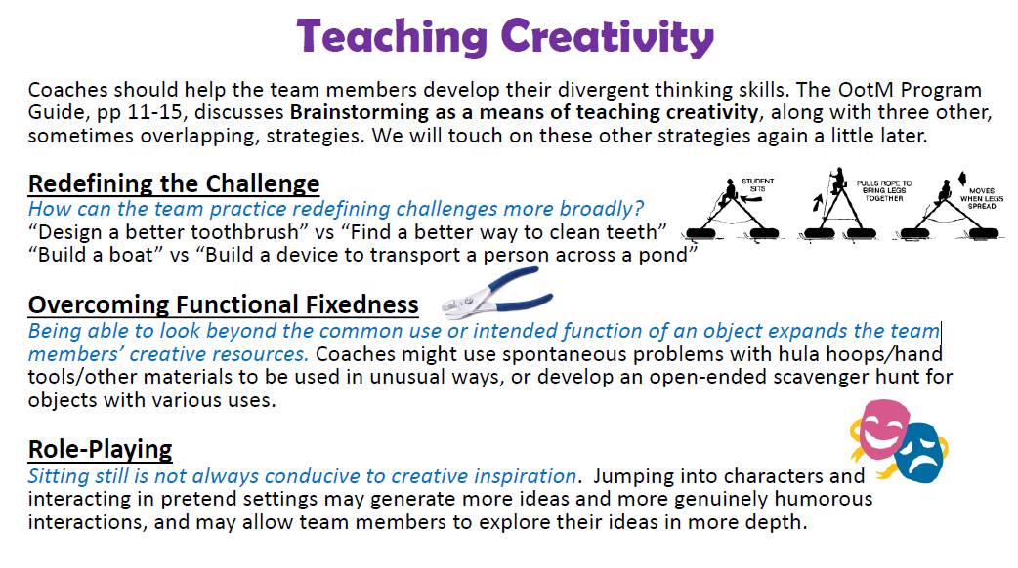

Slide 4
Some Factors That Influence Creativity:
Flexibility: the ability to look at something in a new way
Originality: the talent to think of unusual ideas
Fluency: the ability to generate a great number of ideas
Elaboration: the process of filling in the details
Evaluation: the selection, testing, and revision of ideas
Fearlessness: the willingness to take risks
Brainstorming requires many of these skills. Team members will have different strengths and weaknesses. Good brainstorming can help team members further develop their skills in all these areas.
Good brainstorming also can help students learn important skills for working within a group, such as listening to others’ ideas, clearly expressing and advocating for their own ideas, and giving constructive criticism.

Slide 5





GOALS OF BRAINSTORMING
Generate a lot of ideas
Find the best ideas
Find practical solutions to obstacles
WHEN TO BRAINSTORM
At the beginning, in the middle, any time really
Whenever a team member or the whole team is stuck
Not necessarily all at one time, teams may need to take a break, do something else, and come back to it later in their meeting or over the course of several meetings
BRAINSTORMING STEPS
Prepare the Team Environment
Generate A Lot of Ideas
Evaluate and Narrow the Ideas
Choose an Idea

Slide 6

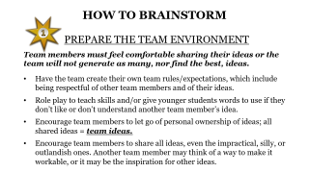
HOW TO BRAINSTORM
PREPARE THE TEAM ENVIRONMENT
Team members must feel comfortable sharing their ideas or the team will not generate as many, nor find the best, ideas.
Have the team create their own team rules/expectations, which include being respectful of other team members and of their ideas.
Role play to teach skills and/or give younger students words to use if they don’t like or don’t understand another team member’s idea.
Encourage team members to let go of personal ownership of ideas; all shared ideas = team ideas.
Encourage team members to share all ideas, even the impractical, silly, or outlandish ones. Another team member may think of a way to make it workable, or it may be the inspiration for other ideas.

Slide 7

HOW TO BRAINSTORM
GENERATE A LOT OF IDEAS
The more ideas the team considers, the better (to a point). They should not discount an idea, nor commit to an idea, too quickly.
Feasibility is NOT a limitation at this point. Impractical, or even seemingly impossible, ideas are welcome. They will deal with reality in the next step.
Some Methods for Generating Ideas:
LISTS
GROUP THINK
CAROUSEL
JIGSAW
STICKY NOTES

Slide 8

LISTS
Each team member makes a list of 10 ideas on their own, then shares all, or a few favorites, with the team. Making a list requires more than a few ideas and discourages settling on the first or only idea.
Some Reasons to Use Lists:
They are a good way to get started.
Team members aren’t generating many ideas.
Some team members are not actively participating.
Some team members are struggling to be heard.
Team members are spinning their wheels with their current idea and haven’t stopped to consider alternatives.
VIRTUAL – Team members’ individual work beforehand can make virtual meetings more efficient and focused.
_____________________________________
Elaborating on Lists – Have team members choose one or more ideas from their list and think of ideas related them. (From a list of 10 settings, choose 3 of those settings and think of 3 possible main characters for each.)

Slide 9

GROUP THINK
All team members share their ideas collectively until they have generated as many as possible. The coach may act as a scribe, but must be careful not to elaborate on, or modify, the team ideas.
Some Reasons to Use Group Think:
Big decisions, such as setting or theme, need to be resolved by the whole team before they can start working on other parts of their long-term problem.
Some are stuck and need to hear others’ ideas to jumpstart their own.
The group discussions, and the flexible format of group think in particular, help the team members build on each others’ ideas, suggest modifications, and raise and respond to concerns in an efficient and productive manner.
VIRTUAL – The whole group working together may help with their sense of connectedness despite physical separation.

Slide 10

CAROUSEL
Team members take turns, usually in an order, sharing ideas or giving feedback on an idea. The coach may act as a scribe, but must be careful not to elaborate on, or modify, the team ideas.
Some Reasons to Use Carousel:
One or more team members are dominating group discussions.
One or more team members are not actively participating in discussions.
Team members are arguing during group discussions and need clear rules about whose turn it is to speak.
Big decisions need to be resolved by the whole team before they can start working on other parts of their long-term problem.
VIRTUAL – Clear rules about whose turn it is to speak may be necessary during virtual meetings to avoid team members talking over each other.
This Photo by Unknown Author is licensed under CC BY

Slide 11

JIGSAW
Divide the team into two or three smaller groups to brainstorm about the same element, or different elements, of the problem. The smaller groups then come back together to share their ideas. The team can choose their favorite ideas, combine them, or use them as a jumping off point for other ideas.
Some Reasons to Use Jigsaw:
One or more team members are dominating group think.
One or more team members are more comfortable sharing
ideas in a smaller group setting.
Some team members work together better than others.
Team members have different strengths which can be best used
by allowing them to focus on certain areas.
There are a lot of decisions to be made and the group think process is inefficient.
VIRTUAL – Team members in the same family, cohort, or other “bubble” may be able to work together in-person and report back to the team virtually.
This Photo by Unknown Author is licensed under CC BY-NC
This Photo by Unknown Author is licensed under CC BY-NC

Slide 12
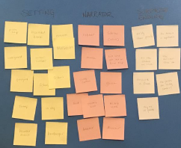
STICKY NOTES
The problem is broken down into several of its required parts, each with its own sticky note color. Team members write their ideas on sticky notes. All of the sticky notes are put on a table/board as team ideas to be considered.
Some Reasons to Use Sticky Notes:
One or more team members are hesitant to share their ideas in group think.
The team is better able to evaluate ideas on their merits when shared anonymously.
There are a lot of decisions to be made and it will be more efficient to evaluate ideas for several elements at one time.
Team members are able to think about, piggyback, and consider twists on others’ ideas when they are not focused on getting their original ideas out.
VIRTUAL – Padlet.com allows team members to type their ideas on virtual sticky notes and put them on a shared padlet during virtual/hybrid meetings.

Slide 13
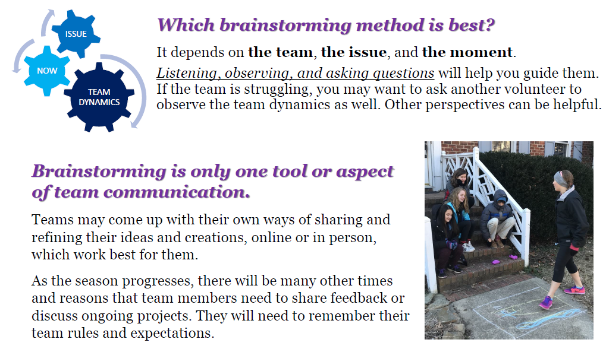

Slide 14
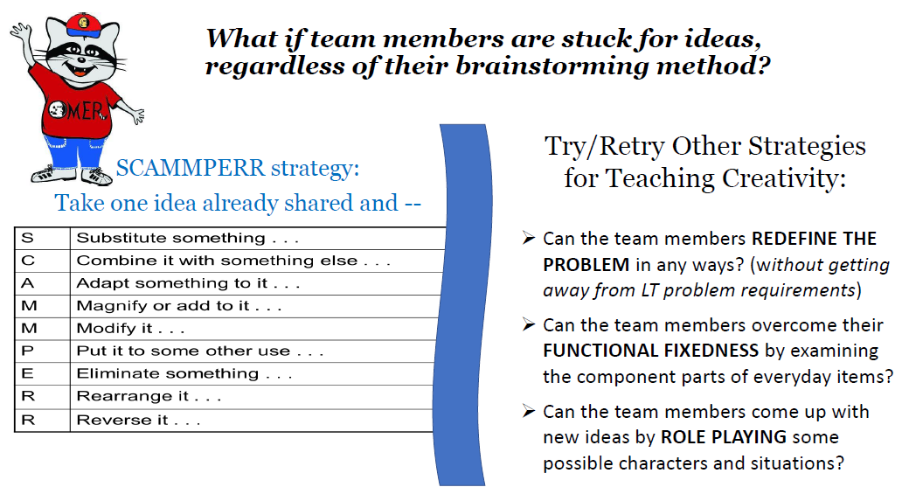

Slide 15
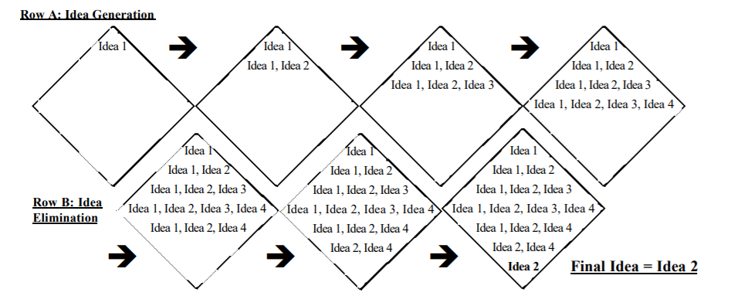
DIAMOND
Underlying all of the methods described so far is the Diamond Brainstorming Method premise that a team should build on their initial ideas and seek to exhaust all of their possible ideas before evaluating and eliminating all but the final one. This is not necessarily included as a separate method, but because it provides a nice visual representation of all of the brainstorming processes.
And because it is a good segue into the next step . . .

Slide 16

HOW TO BRAINSTORM
EVALUATE AND NARROW THE IDEAS
Review your team rules and/or prior discussions about how to respond to ideas that they do not initially understand or like.
Teams should group similar ideas into manageable categories.
Encourage team members to focus on long-term problem language when advocating for, or expressing concerns about, an idea.
Encourage team members to be specific about their concerns, rather than making general negative statements.
Second City’s “Two-Strike Rule” – Suggest an idea. If not accepted the 1st time, you may clarify/modify/add to it. If not accepted the 2nd time, let it go.
Teams should promptly eliminate ideas that have been fully considered and rejected so they can efficiently narrow their choices.

Slide 17
Idea Generation Methods Work In Reverse for Narrowing Ideas
LISTS: For each of 2 final ideas, make a list of 5 ideas for the required narrator character and 5 ideas for the required surprise ending. Do these elaborations make the team member more or less enthusiastic about either final idea?
GROUP THINK: Discuss the pros/cons, possible elaborations, and/or concerns about each remaining idea. Build on the collaborative input of all the team members.
CAROUSEL: Each team member takes turns making an argument for an idea they like or expressing concerns about an idea they want to eliminate.
JIGSAW: Small groups discuss and present elaboration ideas and/or concerns for each remaining idea.
STICKY NOTES: Each team member writes down an argument for/against each remaining idea, or a suggests an elaboration for one of the remaining ideas.

Slide 18

HOW TO BRAINSTORM
CHOOSE AN IDEA
Teams should try to avoid voting, if at all possible, because it divides the team into “sides” with winners and losers.
Teams should exhaust all strategies in Step 3 first. As the team tries to flesh out both remaining problem solutions ideas, does one become more popular? Is there a way to combine the ideas or some elements of both ideas?
Teams may want to find or create their own decision matrix. There are resources online. A decision matrix is a chart of relevant factors with a rating scale assigned to each. This allows the team to evaluate each idea more objectively. The mere act of creating a decision matrix may help the team evaluate ideas better from the outset. The earlier in the process the team creates their matrix, the more objective it will be.
Sometimes teams have to vote and that’s okay too.
Once a team has selected an idea, they should try not to rethink it. Unless they have found some fatal flaw in their idea, continuing to debate it takes away time, focus, and energy from their problem solution.

